Slide 1
Welcome to

Slide 2
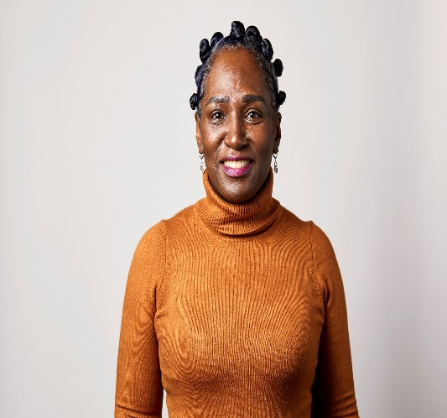
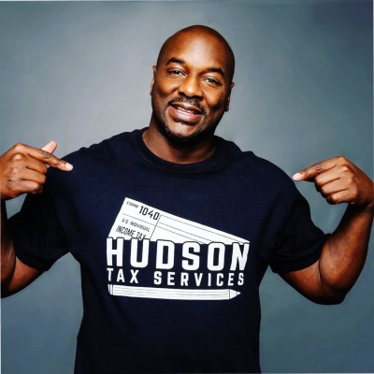
WELCOME
Welcome to
Tuesday, January 16, 2024
Our Team
SHARON NEILSON, MAOL
Program Manager
ECE Reinvestment Fund
DESMOND HUDSON, EA
Enrolled Agent, a Federal Authorized Tax Practitioner
This program is made possible with support from Vanguard Strong Start for Kids Program™

Slide 3
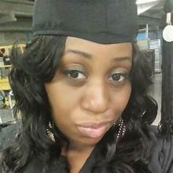
Supervisor of Provider/STARS
Cheri Howard, M.ED/C.I.

Slide 4
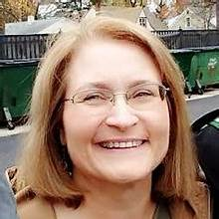
Assistant Director of Provider/STARS ELRC
Diane Getzinger

Slide 5
Innovative Models for Organizations
Teri Bell
teri.bell@reinvestment.com
215.574.5951
Let’s Stay Connected
Business & Financial Consultant
Desmond Hudson
Enrolled Agent
Dhudson@hudsontaxservices.com
267.603.3487
Peer Networking & Knowledge Sharing
Sharon Neilson
sharon.neilson@reinvestment.com
215.868.1661
Peer Networking & Knowledge Sharing
Jacqueline Hinnant
Jhinnant@PHMC.org
267.846.0979
Join our Facebook Group:
Coaching to Success by Reinvestment Fund
Visit our website: www.reinvestment.com/coachingtosuccess
Coaching to Success is managed by Reinvestment Fund and made possible with support from Vanguard Strong Start for Kids Program™.

