Slide 1
Welcome to

Slide 2
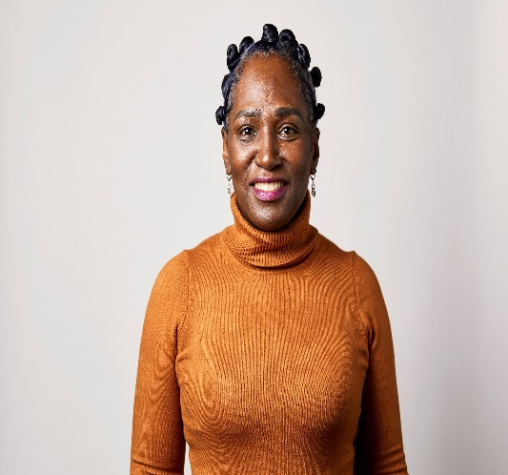
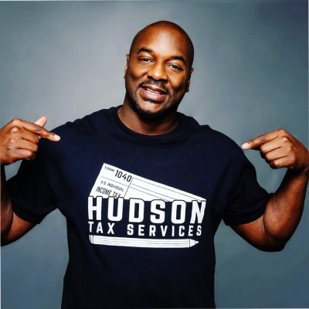
WELCOME
Welcome to
Friday, December 15, 2023
Our Team
SHARON NEILSON, MAOL
Program Manager
ECE Reinvestment Fund
DESMOND HUDSON, EA
Enrolled Agent, a Federal Authorized Tax Practitioner
This program is made possible with support from Vanguard Strong Start for Kids Program™

Slide 3
YOU GET A RESOURCE! YOU GET A RESOURCE! YOU GET A RESOURCE!

Slide 4
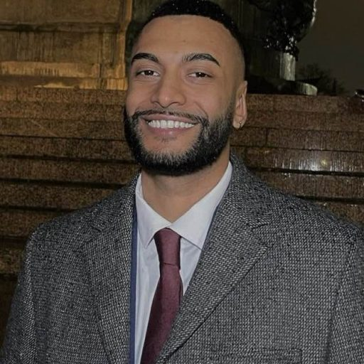
Program Assistant, Healthy Buildings Program, Southeastern PA
Randy Persaud, MPH

Slide 5
Lorna Rosenberg - Healthy Buildings Manager
Randy Persaud - Program Assistant
Chanel Palmer - Research Assistant

Slide 6
Overview
Pittsburgh and Philadelphia
EPA Grant
Partners include Phila Office of Sustainability, Phila Department of Health, First Up, PHMC, ELRC 18, OCDEL, etc.

Slide 7
Healthy Childcare Champion Program
Only in Philadelphia
Target Neighborhoods:
Cobbs Creek
Hunting Park
Strawberry Mansion
Point Breeze
**WILL WORK WITH ANY PROVIDER WITHIN THE CITY**

Slide 9
Healthy Childcare Champion Program
CEHN Eco-Healthy Endorsement
3 Hours for Credit
2 Points for Keystone Stars
WHE Supplies
Enrollment in Women for a Healthy Environment’s Program
Eco-Healthy Checklist
Integrated Pest Management​
Green Cleaning​
Lead exposure prevention:​
Lead dust management​
Lead in drinking water​
Safe toys & furniture​
Indoor and outdoor air quality​
Plastics

Slide 10
Accomplishments
60+ Healthy Childcare Champions
2 webinars on Preparing for Summer and Indoor/Outdoor Air Quality​
Health and Wellness Fair​
Visit by EPA administrator to KenCrest North​
Research Projects
Shade Structure
Air Quality Monitoring
WHE Air Quality Kits
Shade Structure distribution to Healthy Childcare Champions

Slide 11
CONTACT US
Lorna Rosenberg
Randy Persaud
Chanel Palmer
Healthy Buildings Program Manager
Program Assistant
Research Assistant
Lorna@Womenforahealthyenvironment.org
Randy@Womenforahealthyenvironment.org
Chanel@Womenforahealthyenvironment.org

Slide 12
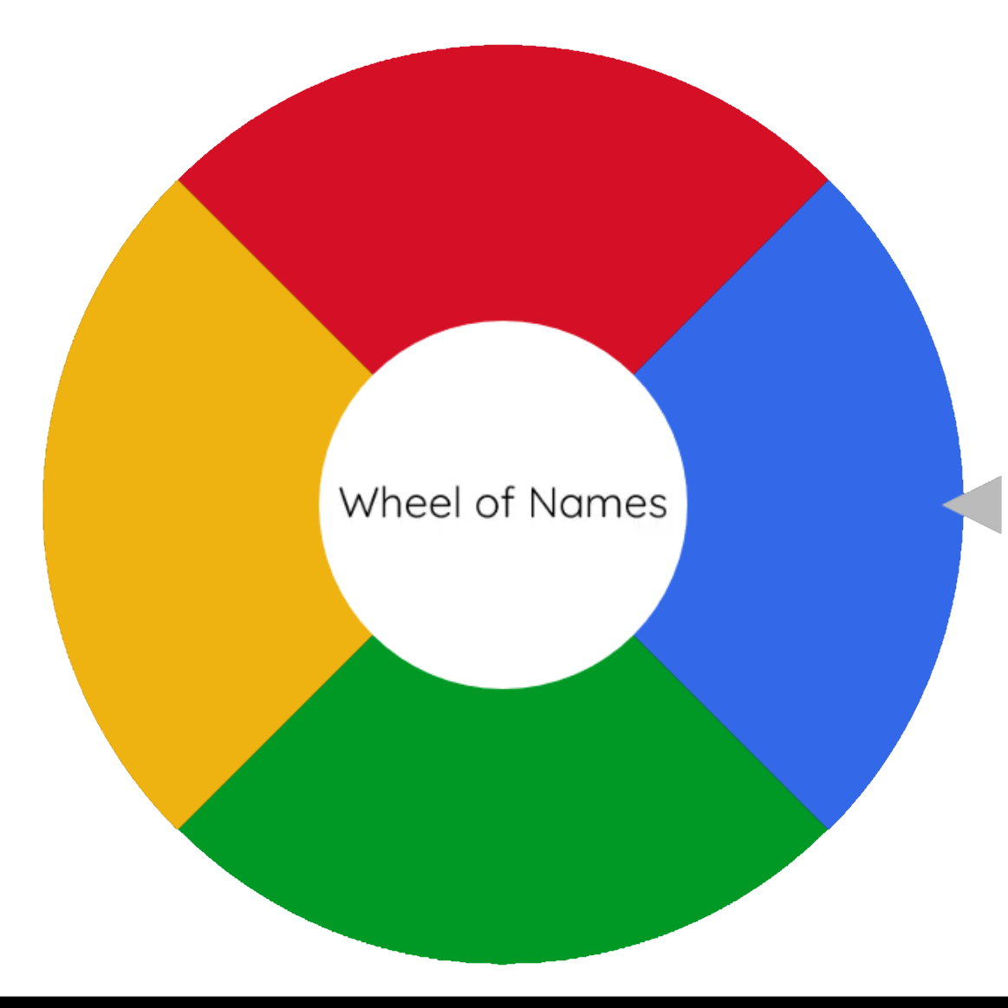
FUN GIVE AWAY

Slide 13
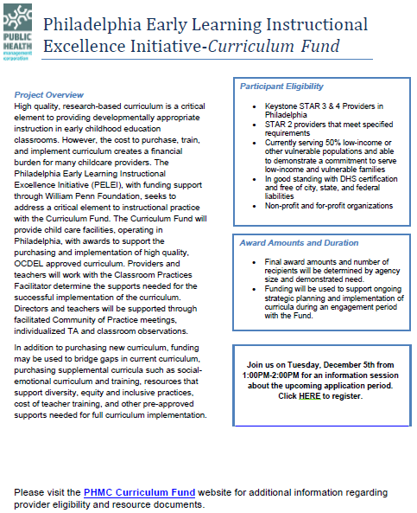
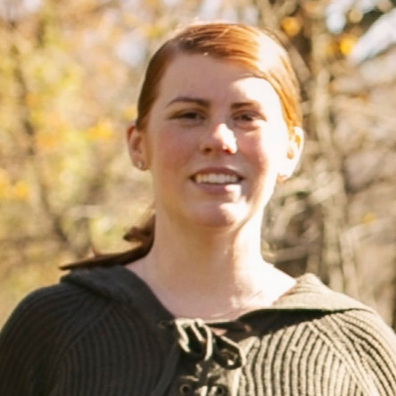
Curriculum Fund Project Manager
Jennifer Sroka has supported the field of early childhood education for 20 years. She has held roles as preschool and school age group supervisor, Head Start teacher, Pennsylvania PreK Counts Teacher, and a curriculum implementation support role

Slide 14
FUN GIVE AWAY

Slide 18
Aliya Johnson-Roberts,
AJR LLC

Slide 19
FUN GIVE AWAY

Slide 23
Empower Wealth
Your Finance Corner
Minnette Taylor

Slide 24
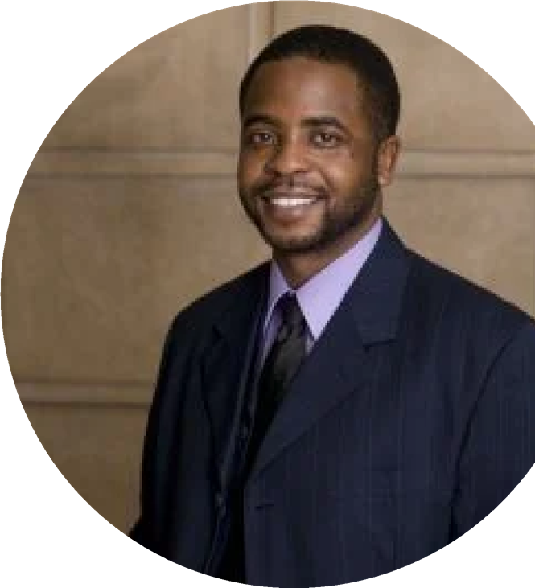
Ebony Suns Enterprises, LLC
Your Green
Business
Coach
We are accepting 10 new business coaching clients
for 2024 to go green, make green, and to do good
with our green. Sign-Up today! Sustain for tomorrow!
Receive business resources, training
and technical assistance with the
following areas of business:
Marketing and Public Relations
Management and Staffing
Money and Access to Capital
Technology and Operations
Real Estate Development
Energy Efficiency
Join @ EbonySuns.com

Slide 25
This series will cover topics such as:
Contracts and Policies
Marketing
Risk Management
Record Keeping for taxes
A FIRST UP INITIATIVE
ALL OUR KIN
FAMILY CHID CARE
BUSINESS SERIES
HOSTED BY
FAMILY CHILD CARE
THE:
ADVISORY COUNCIL
January 8, 2024 - May 13, 2024
Mondays Bi-weekly
6:30-8:30pm, with built in 1hr.
self-study time
Free
10-Week
Series which includes
Pre/Post BAS
Assessments!
You will need a computer to attend Interested? Click here to register.
Made possible by Vanguard Strong Start for Kids Program™
If you have questions or need information, please contact fccbusiness23@gmail.com

Slide 26
Philadelphia VIP
Free Business Law Webinars
Our volunteer attorneys will lead hour-long webinars on six key topics for business owners and nonprofit leaders. Please RSVP using the links below.
Confidentiality & Service Agreements
December 13, 2023
11 am-12 pm
Business Structuring & Corporate Governance
January 17, 2024
11 am-12 pm
Nonprofit Corporate Governance
February 13, 2024
11 am-12 pm
Business Tax Basics
February 28, 2024
11 am-12 pm
Nonprofit Board Structure & Succession Planning
March 13, 2024
11 am-12 pm
Get Free Legal Help from VIP
Philadelphia VIP is the city's "hub of pro bono" since 1981. We recruit volunteer lawyers to represent individuals, small businesses, and nonprofits facing civil legal problems for free.
If you need a lawyer to resolve a legal need, like negotiating a commercial lease, trademarking a logo, or reviewing a contract, please apply for our services below.
Got legal questions? You can also apply for a free one-hour Ask an Attorney consultation from one of our volunteer lawyers.
Apply for Small Business & Nonprofit Legal Help
Browse the Upcoming Webinars Here

Slide 27
5 Surprisingly Legal Ways to Escape Debt
https://www.thepennyhoarder.com/
Get up to $100.00 from Fiona could help you find offers to cut your interest rate by 70% as soon as tomorrow. Here’s how it works: Fiona can match you with new loan offers at a lower interest rate — as low as 5.20% APR*. That’s 70%* lower than the average credit card interest rate. And it’s the key to finally getting ahead.
2. $10K or more in debt the National Debt Relief establishing your financial stability.
It only takes a few minutes to sign up for a free consultation
3. Get paid $225/mouth while watching movies previews A website called InboxDollars will pay you to watch short video clips online. It takes about one minute to sign up, and you’ll immediately get a $5 bonus to get you started.
4. STOP overpaying at Amazon. That’s exactly what this free service does.
5. Get PAID UP $140/month just for sharing your honest opinion. A free site called Branded Surveys will pay you up to $5 per survey for sharing your thoughts with their brand partners. Taking three quick surveys a day could earn up to $140 each month.
Notes:
To change the image on this slide, select the picture and delete it. Then click the Pictures icon in the placeholder to insert your own image.

Slide 28
Everyone has opinions about things, and for better or for worse, most of us love to share them. But what if you could earn money for doing it — to the tune of $500 a month?
The folks at Thrifty Pig make that possible. They just rolled out a new and improved platform that’s revolutionized the way you interact with market research, offering more product tests than any other survey site out there.

Slide 29
https://www.americanheritagecu.org/about-us/american-heritage-and-the-community/events
Notes:
To change the image on this slide, select the picture and delete it. Then click the Pictures icon in the placeholder to insert your own image.

Slide 30
Withholding Basics
December 13
Hosted by PennWest University Clarion SBDC
Register Here
SBA Lending Basics
December 13
﻿Hosted by Gannon University SBDC
Register Here

Slide 31
I want to remind everyone that Power Up will be starting a new no cost 12 Week Peer Learning Program January 17th. To be part of this program You need to Apply by December 10, 2023. You must be a Business located in Philadelphia, under $1 Million and in operation for 1 year.
Here is the Link to Apply
https://ccp.edu/forms/power-your-business-peer-based-learning-experience-application

Slide 32
Money Monday with Suze Orman
Actionable advice to inspire your financial life.
Financial challenge Listen & Subscribe Podcast
Suze Orman's Women & Money (and everyone smart enough to listen) Podcast on your favorite streaming app.
Financial Preparations to Consider for the Coming Year
Are you financially prepared for the new year? Listen to Sunday's podcast to learn about upcoming changes to retirement accounts in 2024, insights on treasuries, strategies for stock market investments, and other financial preparations for 2024. Listen in and subscribe to Suze Orman's Women & Money (and everyone smart enough to listen) Podcast on your favorite streaming app.

Slide 33
You Must Register Your Business First!!
https://pennsylvania.grantwatch.com/cat/26/preschool-grants.html
Notes:
To change the image on this slide, select the picture and delete it. Then click the Pictures icon in the placeholder to insert your own image.

Slide 34
FUN GIVE AWAY

Slide 38
Coming Soon
OCDEL KEYSTONE STARS Continuing Quality Approvement Award for STAR 2-4 Providers

Slide 39
Additional Resources
Reading Captains: https://www.readby4th.org/
High Scope (free): https://highscope.org/
Power Up Your Business:
https://www.ccp.edu/workforce-development-and-economic-innovation/small-business-resources/power-your-business
The National Association for Family Child Care: https://nafcc.org/
Temple Fox School of Business: https://www.fox.temple.edu/news/2023/04/sustainability-small-business
Creative Movement and Music Teaching Artists | KWEST Arts
https://settlementmusic.org/opportunities/creative-movement-and-music-teaching-artists-kwest-arts/
Notes:
Reading Captains - We’re a powerful movement of family, community and system leaders working together to make sure Philly’s children become the strong readers they deserve to be.
High Scope - To close the opportunity gap through high-quality early childhood education.
Power Up Your Business - Power Up Your Business is a FREE, neighborhood-based approach to support small business owners in Philadelphia—like you—to give you the tools you need to grow your business and help your community thrive.
NAFCC-The National Association for Family Child Care (NAFCC) is the only national professional association dedicated to promoting high-quality early childhood experiences in the unique environment of family child care programs.
Temple- Helping Companies recognizing the importance of taking responsibility for their environmental impact.
KWEST-Kaleidoscope Wants Everyone Succeeding Together through the Arts - successfully centered arts within its curriculum for over thirty years

Slide 40
FUN GIVE AWAY

Slide 41
Innovative Models for Organizations
Teri Bell
teri.bell@reinvestment.com
215.574.5951
Let’s Stay Connected
Business & Financial Consultant
Desmond Hudson
Enrolled Agent
Dhudson@hudsontaxservices.com
267.603.3487
Peer Networking & Knowledge Sharing
Sharon Neilson
sharon.neilson@reinvestment.com
215.868.1661
Peer Networking & Knowledge Sharing
Jacqueline Hinnant
Jhinnant@PHMC.org
267.846.0979
Join our Facebook Group:
Coaching to Success by Reinvestment Fund
Visit our website: www.reinvestment.com/coachingtosuccess
Coaching to Success is managed by Reinvestment Fund and made possible with support from Vanguard Strong Start for Kids Program™.

